Slide 1
Spending suggestion
Jessica Lai

Slide 2
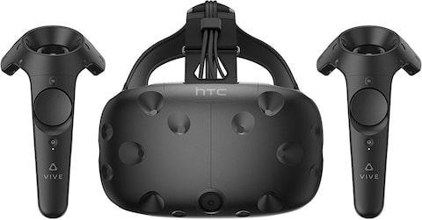
Arguably the best VR headset

Slide 3
HTC Vive - Overview
Developed by HTC and Valve
Released April 5th 2016
Notes:
Valve owns steam

Slide 4
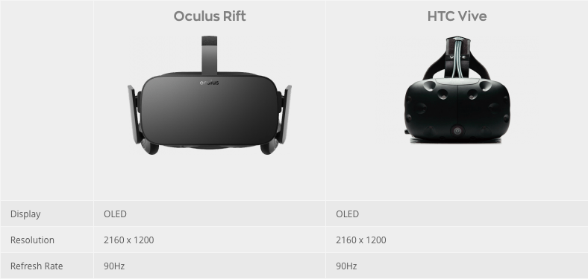
https://www.digitaltrends.com/virtual-reality/oculus-rift-vs-htc-vive/

Slide 5
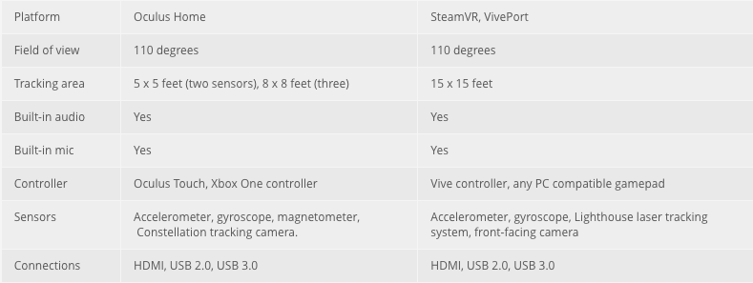
Notes:
Vive has wide range of motion. And is more suitable for moving.
Price of controller, honestly it comes with the set but it’s easier to get a temp one for vive it seems.
Xbox controller = 59.95
touch = 99
Vive controller = 180
There’s some differences in the tracking technologies. Main difference is the front facing camera for Vive which could allow see through.

Slide 6
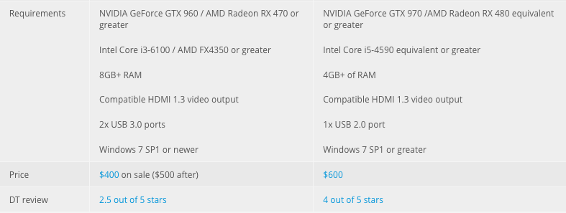
Notes:
Vive has higher pc requirements but they both need pretty high end pcs.

Slide 7
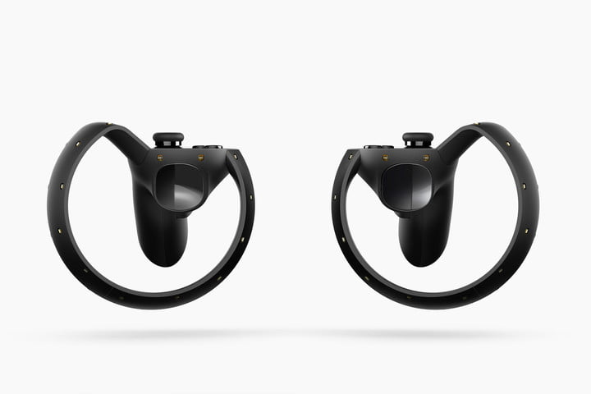
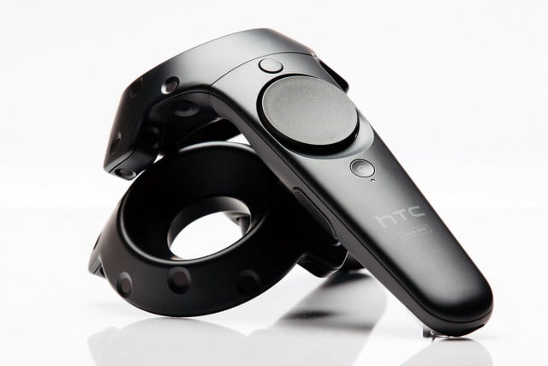
Notes:
Touch - joystick button. Real hand set up
Vive - Touch pad and grip button

Slide 8
Other considerations
Pros
Sync with phone over bluetooth even in VR experience
Steam targeted
Cons
Heavier
https://www.tomsguide.com/us/oculus-rift-vs-htc-vive,review-3433.html

Slide 9
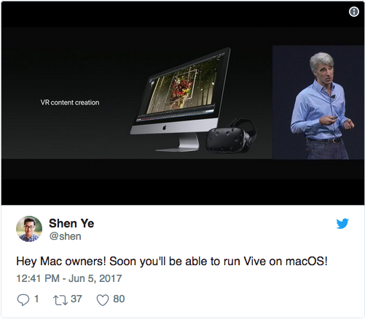
Mac support coming
HTC vive coming to Mac
SteamVR is brought to Mac
AMD Radeon RX 580 graphics card
connect via Thunderbolt 3
http://www.pcgamer.com/apple-is-bringing-steamvr-and-htc-vive-support-to-macs/
Notes:
I’m the only person who cares but, Vive seems to be getting ahead on vr support for mac users. Although it’s still a pricey solution, at least it’s a good start.

Slide 10
Development
Steam VR
Open VR SDK to target Steam VR
Viveport SDK
Unreal Engine 4
Unity
Native Code
Open VR input emulator - open source on github
Notes:
There is no clear emulator for vive development.

Slide 11
Add ons

Slide 12
Real time eye tracking
aGlass
Foveated rendering -> less work on PC -> lower hardware requirements
200, 400, 600 lens + custom
Tobii eye tracking
Vive business edition
aGlass is ~$250 on 7invensun website
Notes:
aGlass - Only rendering things you’re looking at in high resolution
But price is listed in chinese so I’m somewhat doubtful about the ability to purchase it in the US

Slide 13
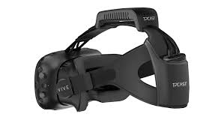
Wireless experience
TPcast
Displaylink
Rivvr
KwikVR
TPcast preorders open again at $299
Notes:
Finally open again in North America.

Slide 14
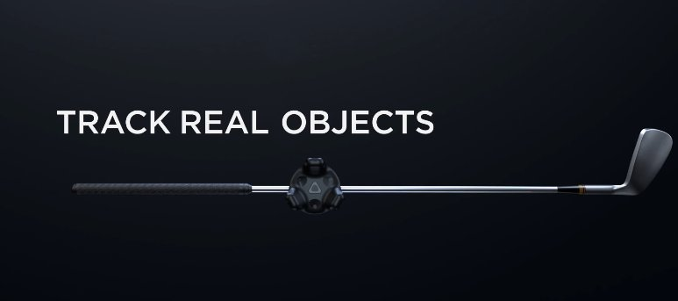
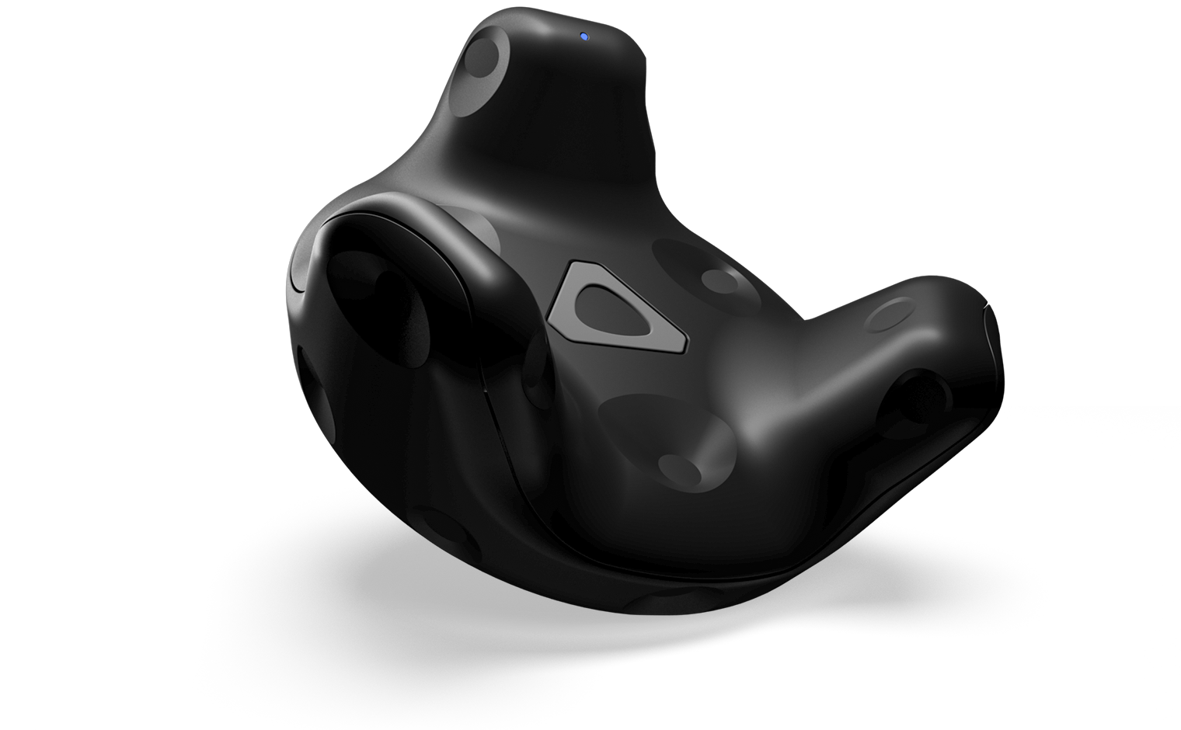
Vive tracker
Available for $99.00
Notes:
And there is plenty of companies working on tracking gloves.

